Slide 1



CKPC PROPERTIES
HEAD OFFICE, GUTTAHALLI BANGALORE
VASTU STRATEGIC ANALYSIS-05
Site visited on-25th June, 2026
VR/169/26

Slide 2
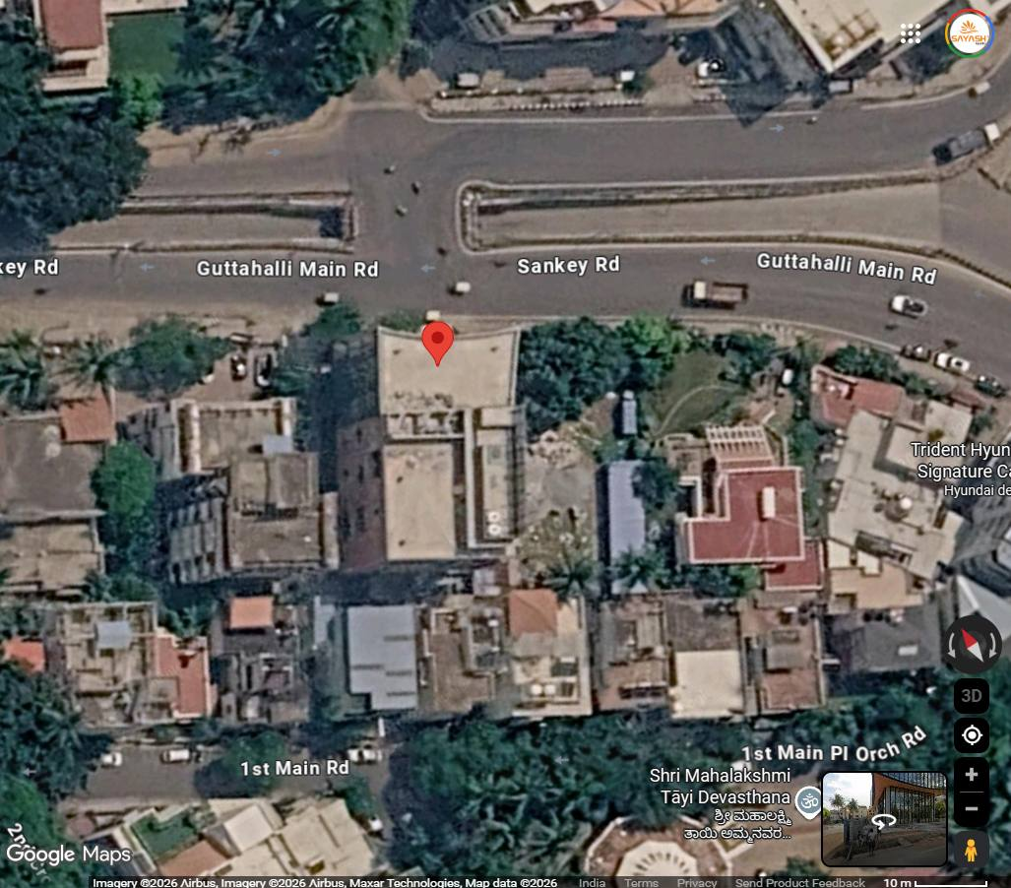
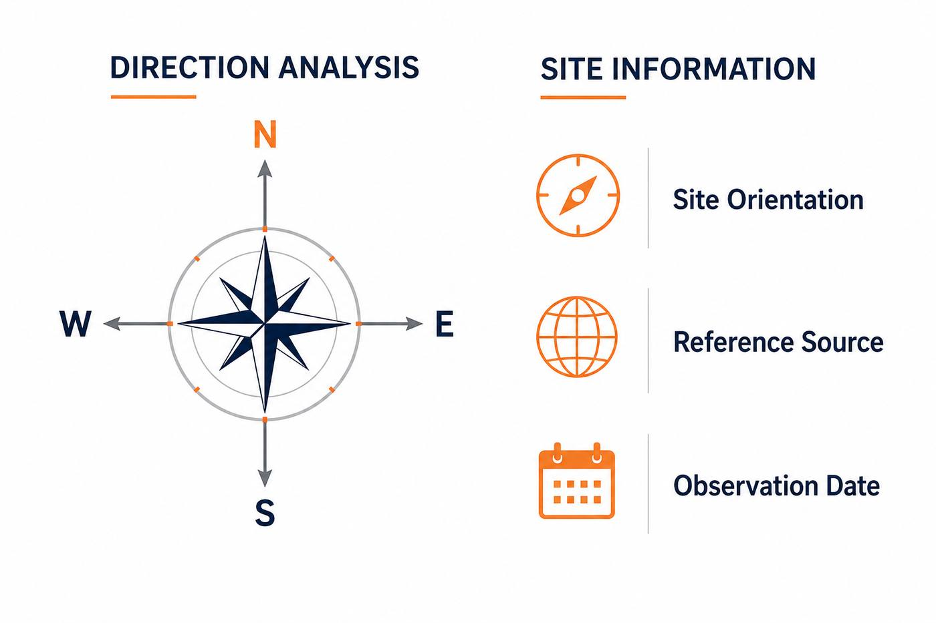

NORTH ALIGNMENT
PROJECT:
Head Office, Guttahalli
02
DIRECTION ANALYSIS
The site is North-East Facing.
Tap Here to Open the Location
SITE INFORMATION
Site Orientation
North-East Facing
Reference Source
Google Map
Observation Date
June 2026
SATISH GUPTA & YASH GUPTA
(VASTU CONSULTANTS)

Slide 3
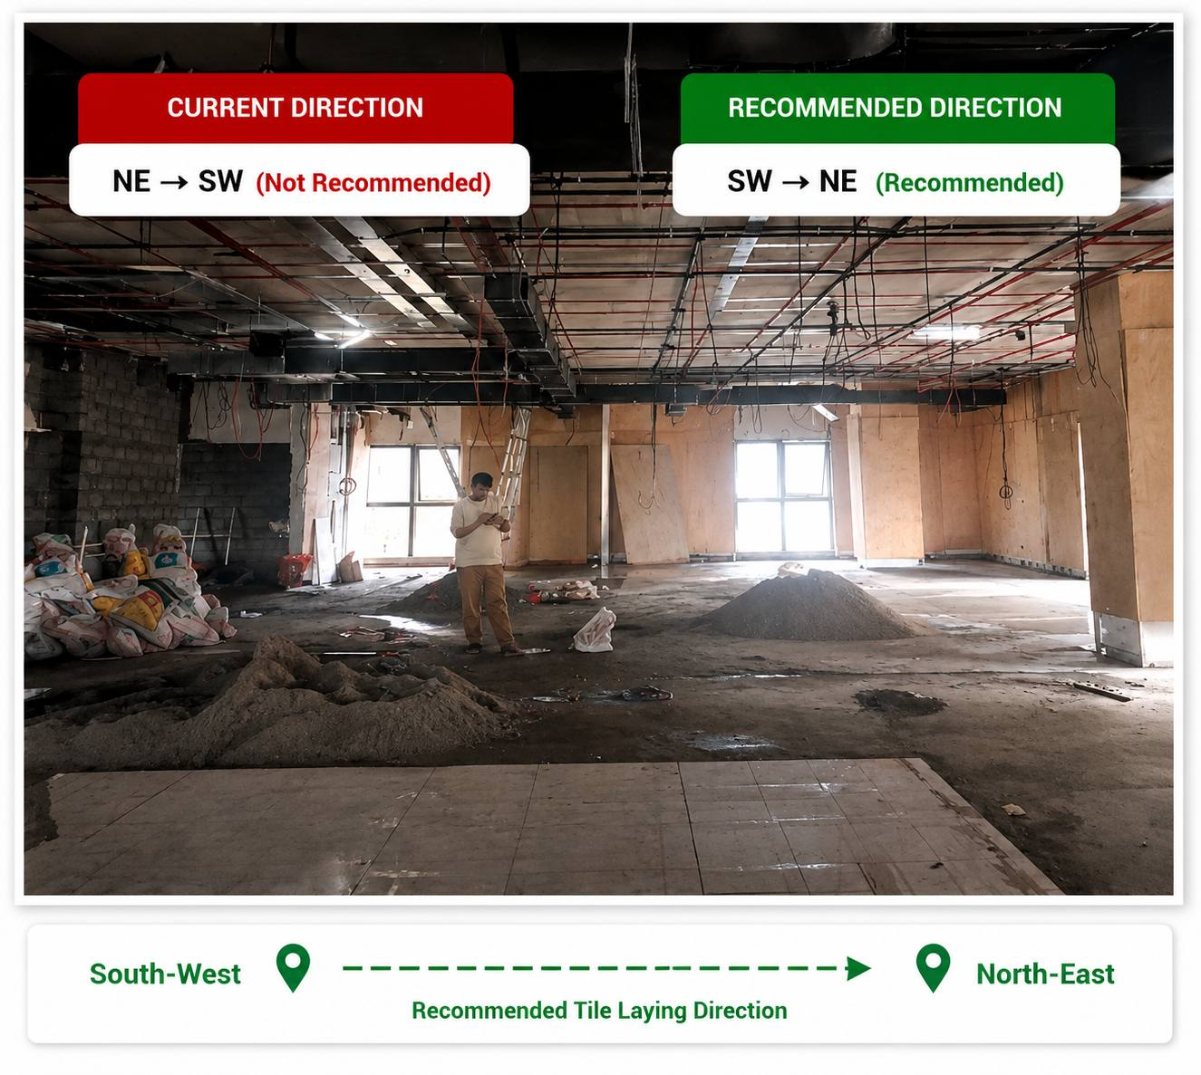

KEY VASTU CONSIDERATIONS
PROJECT:
Head Office, Guttahalli
03
During the site visit, it was observed that the floor tiling on all levels is being laid in the reverse direction as per Vastu principles. Currently, the tile installation is progressing from the North-East towards the South-West, which is not recommended as it may create obstacles and delays in the smooth and timely completion of the project. It is advised that the tile laying should be carried out from the South-West towards the North-East in accordance with Vastu.
SATISH GUPTA & YASH GUPTA
(VASTU CONSULTANTS)

